Slide 1
Medicaid prior authorization process
Advanced Diagnostic Imaging Services

Slide 2

Goals
Become familiar with guidelines for Advanced Imaging Services as defined by the MS Division of Medicaid (DOM) and Kepro
Be able to identify all the key players for Medicaid members
Become better equipped to successfully request prior authorizations for Medicaid members
Take away resources to reduce the administrative burden for the process

Slide 3

Agenda
Introduction
Getting Started
  Eligibility
  Key Players
  Requirements
  ANG Provider Portal
Review Process
  Review types
  Timelines
  First & Second level
  Pend Process
Denials and Reconsiderations
Appeals
Tips
Resources
Questions and Answers

Slide 4



About Us
Acquired eQHealth Solutions in 2021
25-year partnership with DOM
Multidisciplinary review team includes registered nurses and physicians
Advanced Imaging Prior Authorization review since 2015
Provides services to MS State Employees
  These are two totally separate lines of business, with separate policies and procedures and do not overlap
  Very important that you are submitting your request to the appropriate Kepro line of business in order to prevent delays
95% Average customer satisfaction rating
35 YEARS Serving Government Sponsored Healthcare Programs
1.8M UM Reviews a year

Slide 5

Local Kepro Team
Wendy Fields, PAHM, BSN, RN-BC
Project Director
Cindy Rogers, RN
Asst. Project Director and Lead Reviewer
Kimely Summers
Education Specialist and Intake Coordinator
Misti Cochran, RN & Regeana Weeks, RN
RN Reviewers
Chris Phillips, MD
Medical Director and Physician Reviewer

Slide 6

Getting Started

Slide 7

Eligibility Verification
Providers are responsible for checking member eligibility and benefit plan prior to services being rendered and authorization obtained.
It is recommended to check eligibility often AND on the actual day of service, not just once a month.
Verification of Eligibility is provided by Gainwell Technologies thru the MESA system. Eligibility can be verified by:
Automated Voice Response 1-800-884-3222
Website verification
https://medicaid.ms.gov/mesa-portal-for-providers
Don’t always trust the card presented to you -it may not be current.

Slide 8







Key Players
Who do I call for Prior Authorizations?

Slide 9
Key Players
Fee for Service Medicaid members
Alliant Health Solutions
Kepro
MS CAN
Medicaid members enrolled in the Managed Care plans
Magnolia
Molina
United
For all services requiring prior authorization except advanced diagnostic imaging
For advanced diagnostic imaging only (*CPT code list found on our website)
MSCAN provider is identified when you run member eligibility thru MESA

Slide 10



KEPRO Advanced Imaging Exclusions
Exclusions
DUAL Eligibility
MSCAN or CHIP
Authorization is not required from Kepro if the member has Medicare coverage, or any other commercial plan coverage .
Kepro can not provide review services for a member enrolled in MSCAN or CHIP. Providers will need to contact the appropriate managed care provider for authorizations.
Imaging services are not covered for members in the following Aide Category:
Family planning waiver

Slide 11
Advanced Imaging Services
MS Medicaid State Plan
MS Medicaid Administrative Code Part 220: Radiology
MS Medicaid Billing Handbook & Fee Schedule
Advanced Imaging Services are covered by Medicaid when medically necessary and appropriate for the member. Providers should be familiar with Kepro policies and State regulations.
Medicaid.MS.GOV
Kepro Advanced Imaging Services Provider Manual

Slide 12

Requirements
In support of Administrative Code 220: Radiology Services, Kepro requires the following documentation to support medical necessity and appropriateness for requested services:
Valid physician order including diagnosis,
Results of recent clinical evaluation, including treatment history related to stated diagnosis or clinical condition,
Previous imaging studies related to the stated diagnosis and current clinical condition,
Treatment plan related to the stated diagnosis or clinical condition

Slide 13

ANG – Kepro’s Provider Portal
Providers are highly encouraged to use the provider portal to submit requests
Efficient, easy access to enter and verify authorizations
Communicate with Kepro staff when appropriate regarding authorizations
View and print letters with ease
Reduces the “did you receive my fax” burden
Capable of receiving real time authorizations on many CPT codes

Slide 14
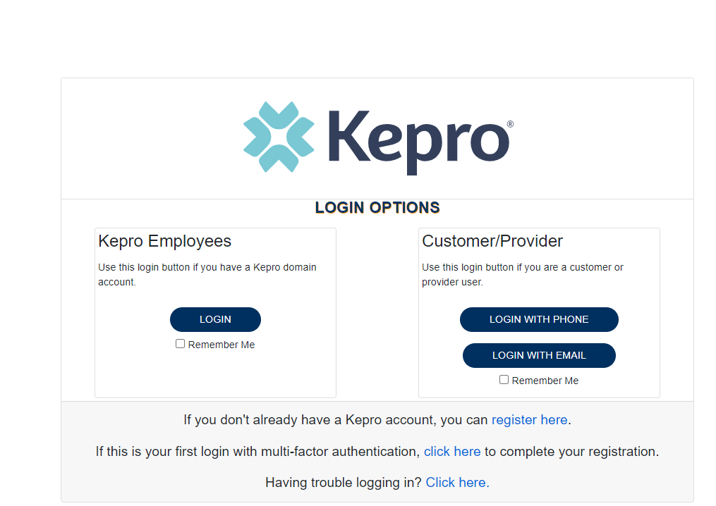
ANG – Kepro’s Provider Portal
ANG trainings were held in September and October. Training videos are available to view online at msadi.Kepro.com
If you need assistance with registering for ANG, please contact us at msadihelp@Kepro.com
If you choose to fax your request, you must complete the appropriate prior authorization form found at msadi.Kepro.com
  Incomplete or illegible forms are rejected and returned to the provider

Slide 15
The Review Process

Slide 16

Authorization Types
Prior Authorization
  Should be submitted at least 3 days before service is rendered
Retrospective Urgent
  Services were performed due to urgent/emergent conditions as defined in Administrative Code
    Does not include care provided in the ER, 23-hour hospital observation or inpatient hospitalization
  Providers must submit the review within 3 business days of the service.
Retrospective Eligibility
  Services were performed when the member was NOT eligible for Medicaid and has since been granted retrospective eligibility covering the date of service.
  Providers must submit a retrospective review within 90 days of the retrospective eligibility determination date

Slide 17

Processing Timelines
Kepro completes requests for services expeditiously and within contractual timeframes. The review completion timeframe is measured from the date Kepro receives a request.
  New Request/Admission review – 2 business days
  Retrospective reviews – 5 business days
  Retrospective Eligibility Reviews – 5 business days
*A review that has been pended will cause the “clock” to stop. When requested information has been received the clock will start new.

Slide 18
Review Process
Administrative Requirements
Nurse Review
Physician Review
State and National, clinical based standard of care are applied
Approve care if medically necessary
Refer to md reviewer if care does not meet medical necessity standards
The medical director, or another qualified physician reviewer, will review the case against national standards of care to provide a decision.
*a physician can approve, pend or deny services
DOM Guidelines are applied
Provider Medicaid Numbers are verified
Member Medicaid numbers are Verified

Slide 19


Pended Reviews
A review may be pended for one of the following reasons:
  Missing required information such as physician order or clinical information to support to the request
  Additional information or clarification is needed before a decision can be made
Notifications are sent via fax or web portal
A provider has 3 business days to respond to an additional information request for a prior authorization and 10 business days for retrospective reviews.
If the requested information is not received within 3 business days, the review will be suspended for up to 45 days.
If the additional information is not received within 45 days, the review will be technically denied for insufficient information.

Slide 20
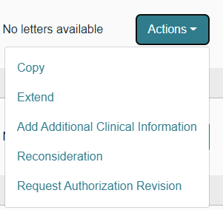
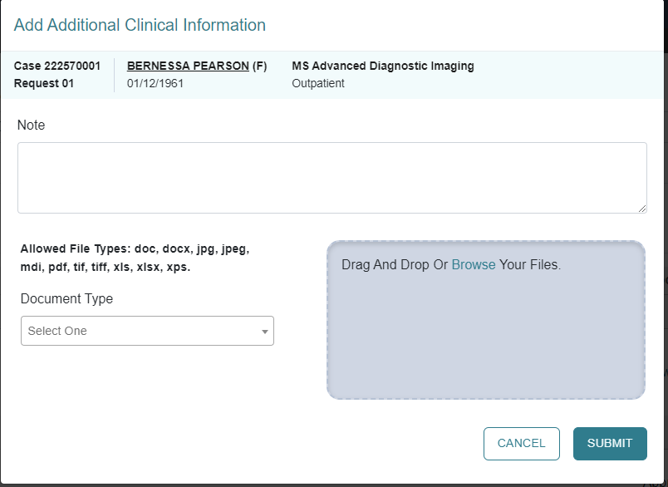
How To Respond To Pended Or Suspended Reviews
If you submitted the request online thru the Portal:
  Log into Portal and open the pended case
  ACTION TAB - Add Additional Clinical Information
  Upload the requested documents or type the information in the note section.
Do not use the Message feature -this will cause unnecessary delays

Slide 21
Denials and Reconsiderations
Technical Denial
Occurs when any portion of the requested services is denied because it did not comply with DOM rules and regulations (administrative)
Reconsiderations
Clinical Denial
Occurs when any portion of requested services is denied by a physician reviewer for clinical reasons
May be requested by the member or provider for any review that received a clinical denial
Denial notifications have specific instructions for requesting reconsideration
Another look at the review by a second physician reviewer

Slide 22

Reconsiderations
A reconsideration may be requested by the member/member’s representative or provider within 30 days of the clinical denial
Providers may submit their reconsideration request 1)thru the portal 2)phone or 3)fax.
  The portal is the preferred method
The review will be assigned to a physician reviewer who was not involved with the initial determination.

Slide 23

Appeals
If a reconsideration is upheld, only the member, parent, or legal guardian/caregiver may request an administrative appeal of the Kepro determination
Administrative appeals must be requested in writing to the Division of Medicaid, within 30 calendar days of the reconsideration notification date.
DOM will conduct the Administrative Appeal (Hearing)

Slide 24

Recap = Tips for Success
Verify eligibility often, especially on day of service
  With Gainwell Technologies
Submit prior authorization requests in plenty of time
  3-5 business days prior to service being performed not 1 month
Submit all the required documents the first time to reduce pends
  Valid Physician order
  Clinical notes dated on or around the date of the order.
    We do not need a copy of the member’s card, two-year-old records, demographic pages or 100 pages of medical records.
    This will only delay your case
  Any relevant imaging studies – X-rays, previous/recent CT, MRI, US etc.
Respond to pended reviews quickly
  Only the information requested and answer the questions, don’t just upload documents.
Utilize the tools we have for you on our website
  List of CPT codes that require authorization
  Videos on how to submit a review
  Provider manual on the program

Slide 25

Kepro Provider Education
Helpline: 866-740-2221
Email: MSADIHELP@Kepro.com
For general questions. Please do not send patient information through the email
For additional resources, forms, videos, etc. visit our website:
MSADI.Kepro.com

Slide 26

Resources
Gainwell Technologies – 1-800-884-3222
DOM website - medicaid.ms.gov
CHIP 1-800-992-9940
Alliant Health –1- 888-224-3067
Magnolia Health –1- 866-912-6285
United Healthcare –1- 877-743-8731
Molina Healthcare –1- 844-809-8438

Slide 27

Questions & Answer

